Slide 1
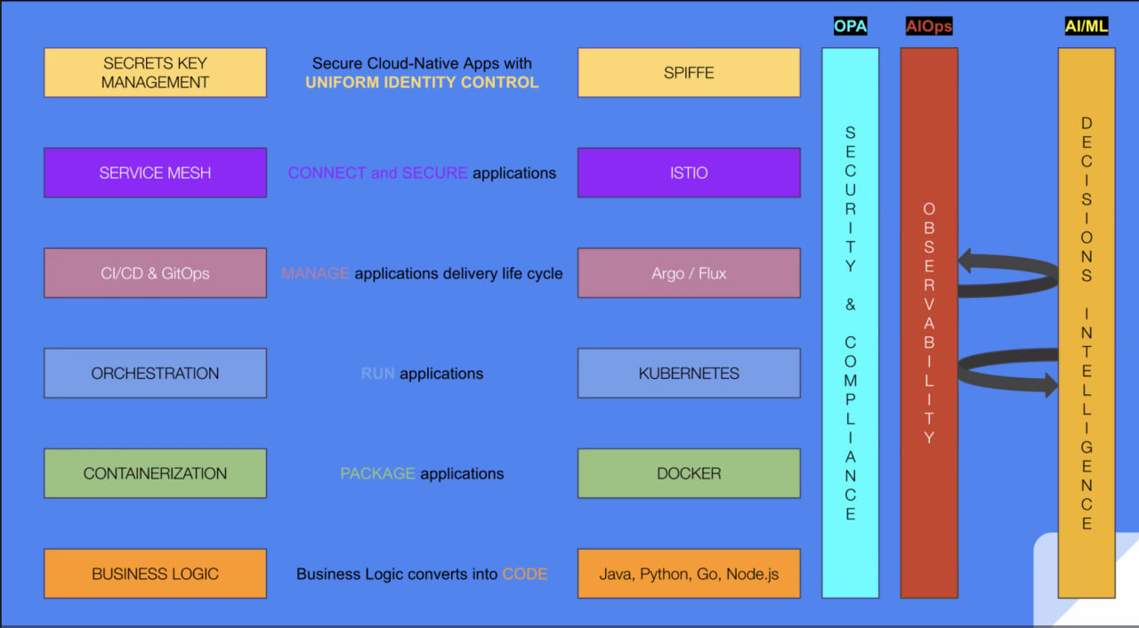
Microservices and Business Logic
Firstly, Microservices are also known as business logic and are written by developers as code using different programming languages.

Slide 2
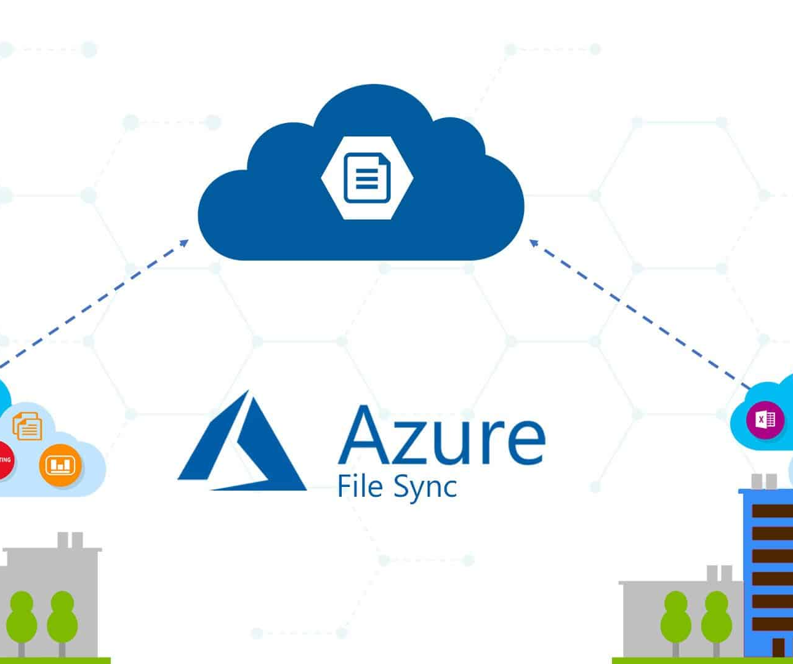
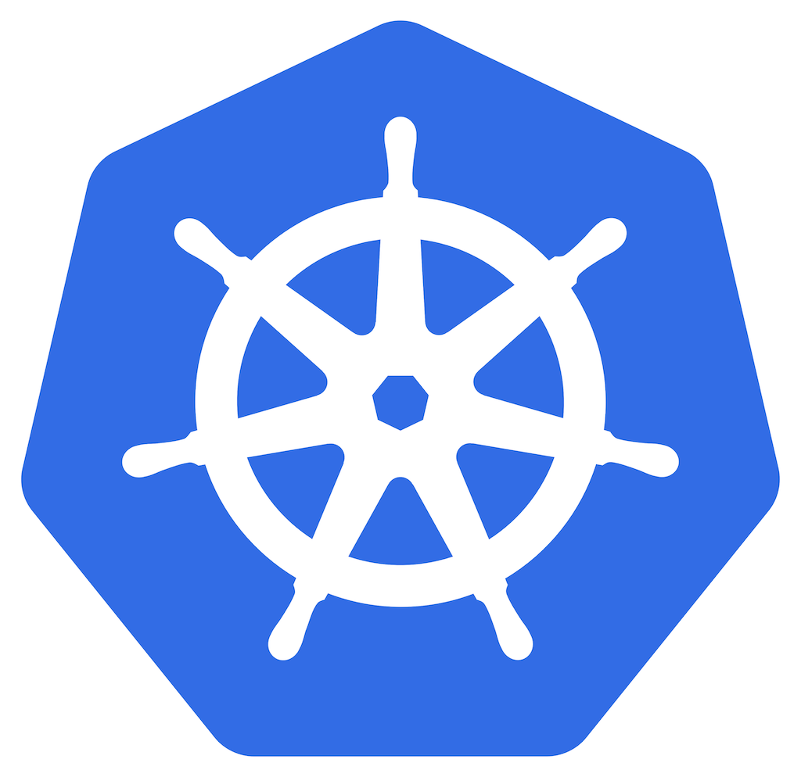
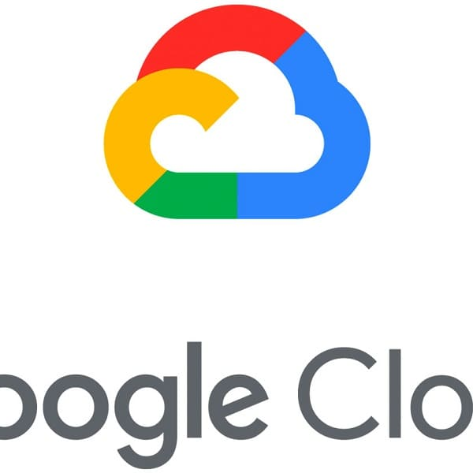

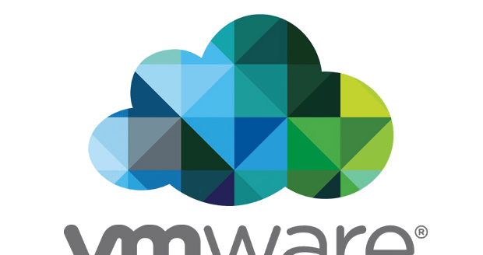
Running Microservices
Secondly, Microservices can be run on various platforms such as VMware, AWS , Google Cloud, Azure, on-premise physical servers, serverless architecture, or on Kubernetes as containers.
This Photo by Unknown author is licensed under CC BY-SA.
This Photo by Unknown author is licensed under CC BY-ND.
This Photo by Unknown author is licensed under CC BY-SA.
This Photo by Unknown author is licensed under CC BY-NC-ND.
This Photo by Unknown author is licensed under CC BY.

